Slide 1



Deep Learning
Pablo Ruiz

Slide 2
Analytical Index
Convolutional Neural Networks (CNN)
Introduction to Computer Vision
Introduction to CNN
Applications
Object Detection
Image Segmentation

Slide 3
2
Convolutional Neural Networks (CNN)

Slide 4
2.1
Introduction to Computer Vision

Slide 5
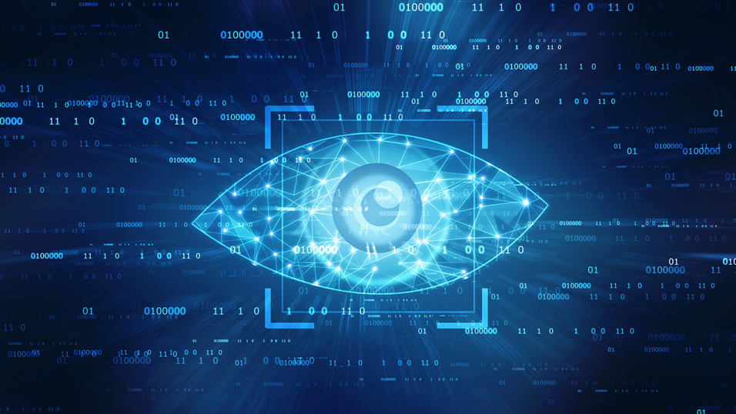
Computer Vision I
Massive growth in visual data:
500 hours of video are uploaded to YouTube every minute.
TikTok has over 1 billion monthly active users that spend 1.5 hours on average per day.
100 million post and 1 billion stories are uploaded to Instagram every day.
There are cameras everywhere.
Techniques and ideas can be used in other types of ordered data.
People create and share visual data continuously.

Slide 6
Computer Vision II
“Building artificial systems that process, perceive and reason about visual data”
Visual Perception: 500 millions of years of evolution, involves both the evaluation of stimulus features and attention (differential processing of selected information that is relevant to behavior)
Importance of computer vision:
Automated analysis and understanding of visual data to enhance human capabilities.
Enables applications in diverse industries, including healthcare, automotive, retail, security, digital marketing…
Notes:
Ejemplo esquimal y radiografía.
La visión artificial, también conocida como visión por computadora (del inglés computer vision) o visión técnica, es una disciplina científica que incluye métodos para adquirir, procesar, analizar y comprender las imágenes del mundo real con el fin de producir información numérica o simbólica para que puedan ser tratados por un ordenador.

Slide 7
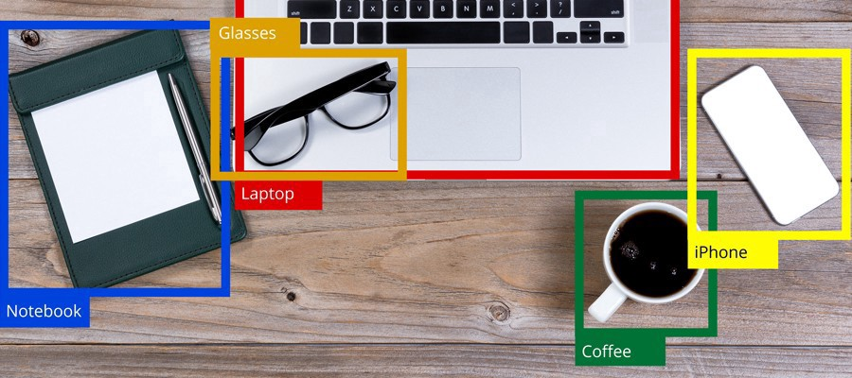
Computer Vision: Image Classification & Location
“Building artificial systems that process, perceive and reason about visual data”
Visual Perception: 500 millions of years of evolution, involves both the evaluation of stimulus features and attention (differential processing of selected information that is relevant to behavior)

Slide 8
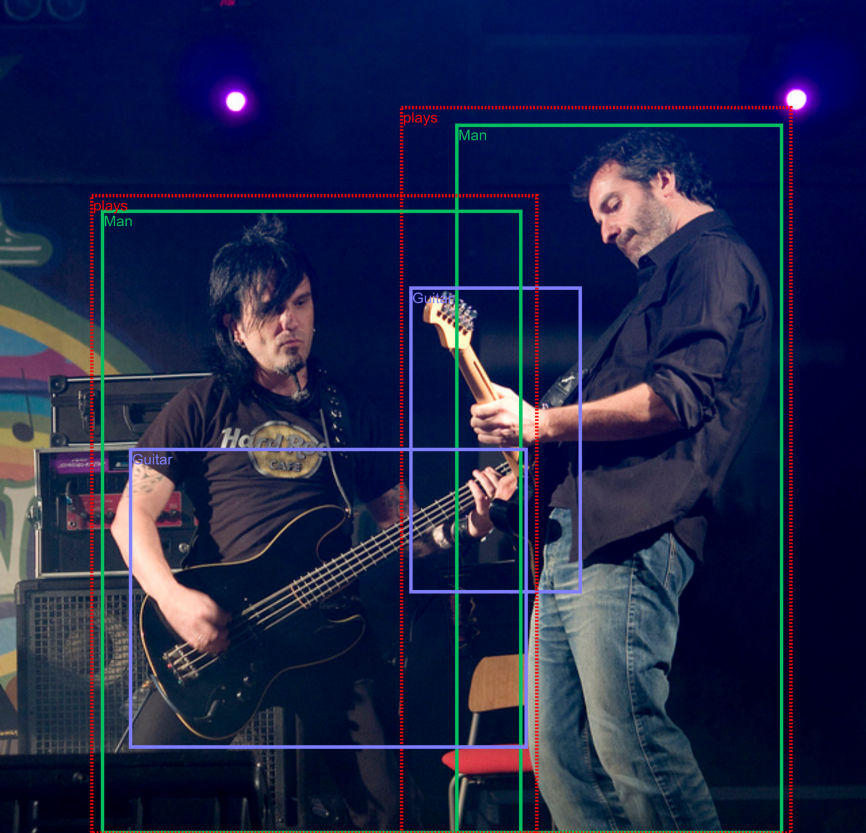
Computer Vision: Relationship Detection

Slide 9
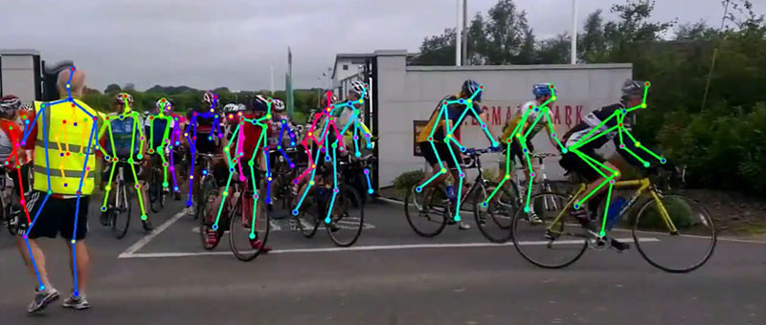
Computer Vision: Pose Estimation
Determines the position and orientation of objects or people, useful in AR, gaming, and healthcare

Slide 10
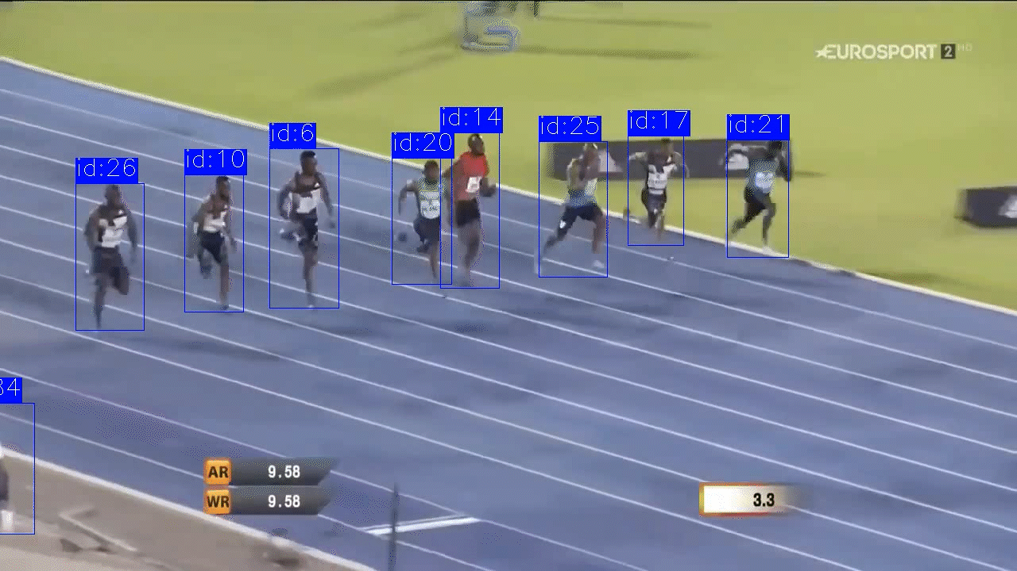
Computer Vision: Object Tracking
Identifies and locates objects within images or video streams, used in retail, security, and many other sectors

Slide 11
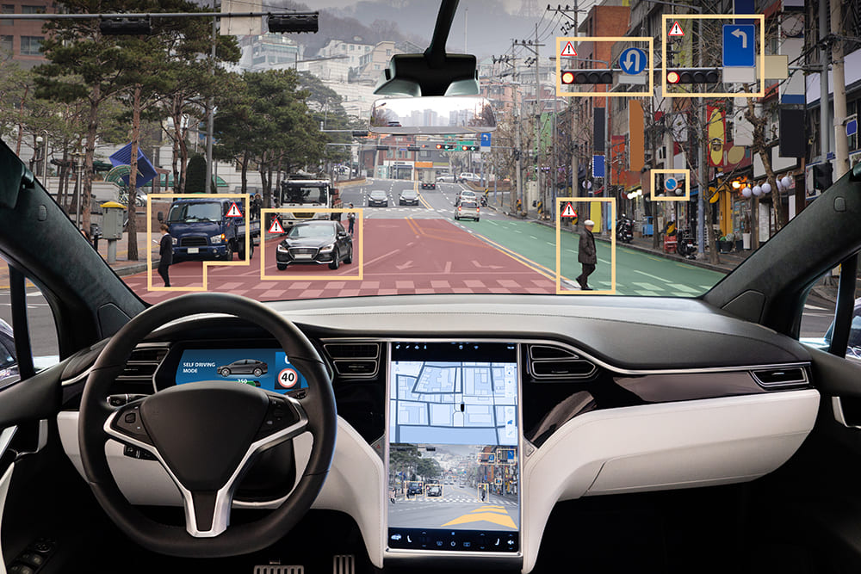
Computer Vision: Self-Driving Cars
Identifies and locates objects within images or video streams, used in retail, security, and many other sectors

Slide 12
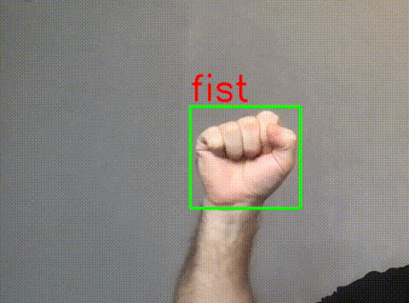
Computer Vision: Gesture Recognition
Interpreting human gestures to control devices or applications, used in gaming, healthcare, and smart home systems.

Slide 13
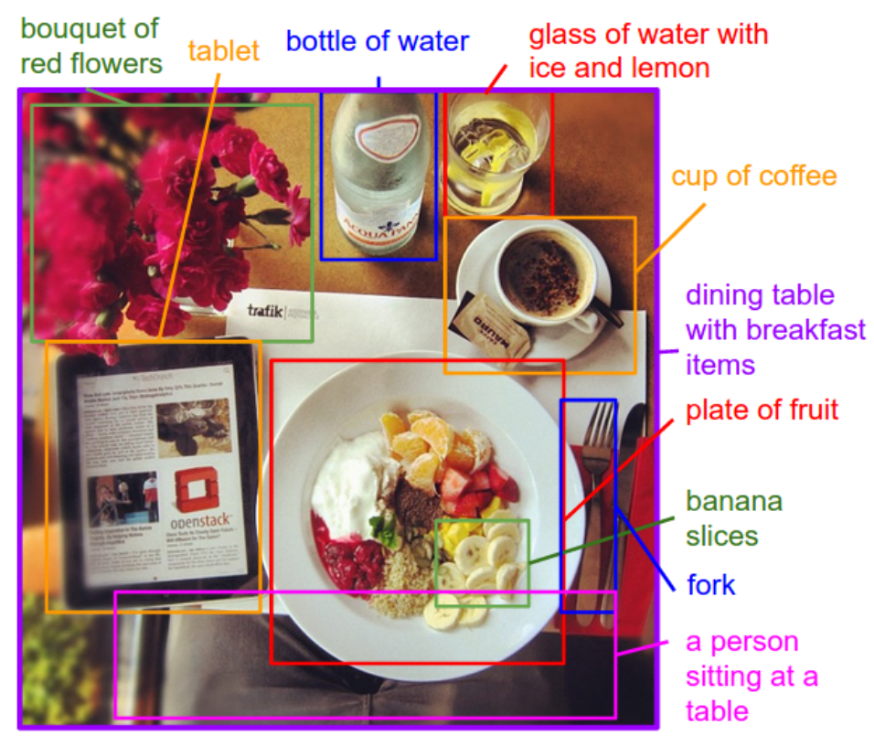
Computer Vision: Image annotation
“Deep Visual-Semantic Alignments for Generating Image Descriptions”, 2015.

Slide 14
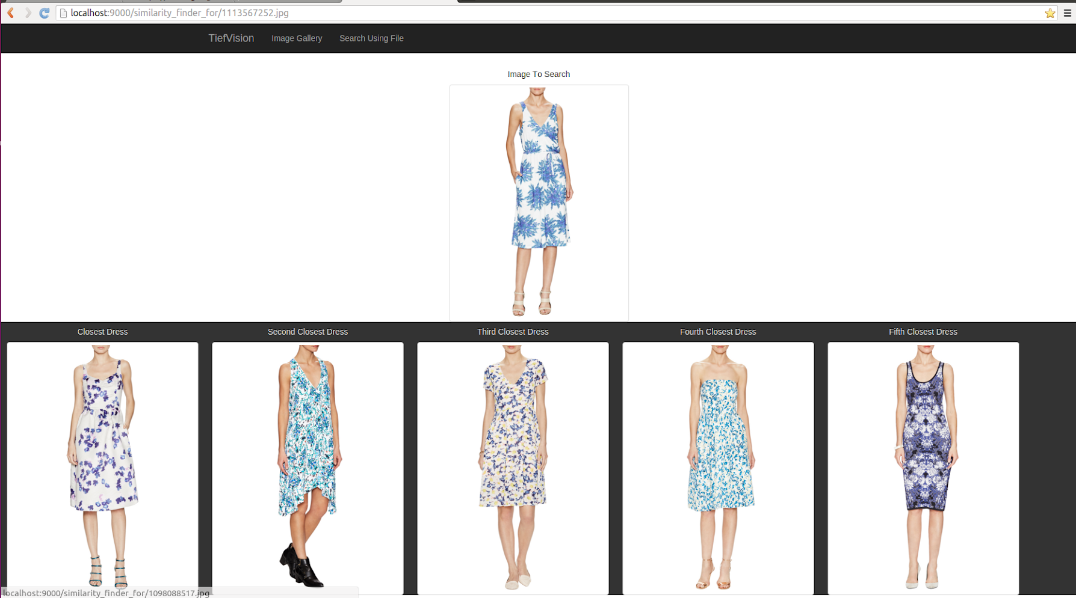
Computer Vision: Image Similarity Search Engine
https://github.com/paucarre/tiefvision

Slide 15
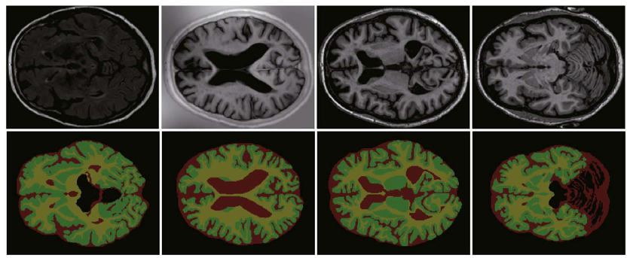
Computer Vision: Image segmentation
Notes:
Image segmentation partitions an image into regions, called segments, for defined purposes of further image analysis, improved efficiency of image compression, or just for visualization effects.

Slide 16


Computer Vision: Image Reconstruction

Slide 17
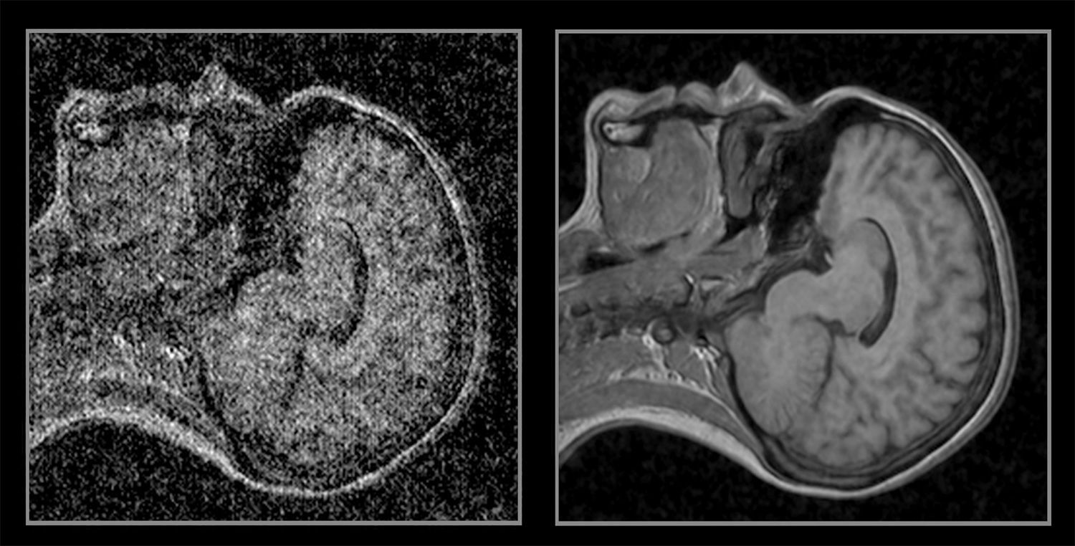
Computer Vision: Image Denoising

Slide 18
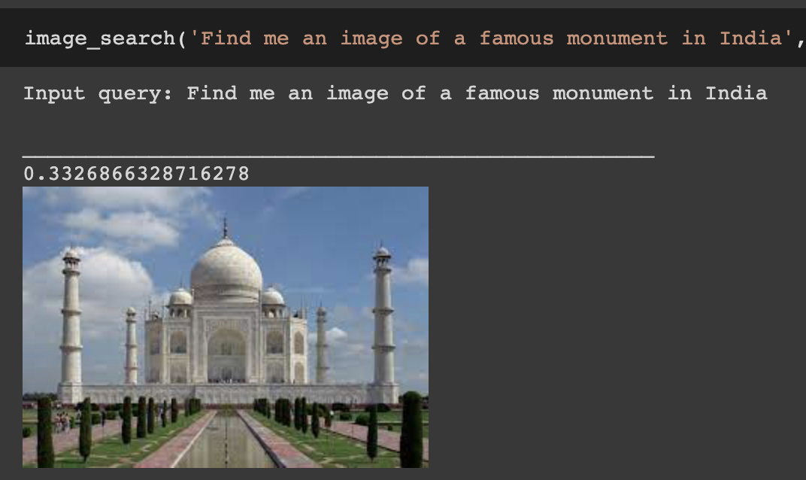
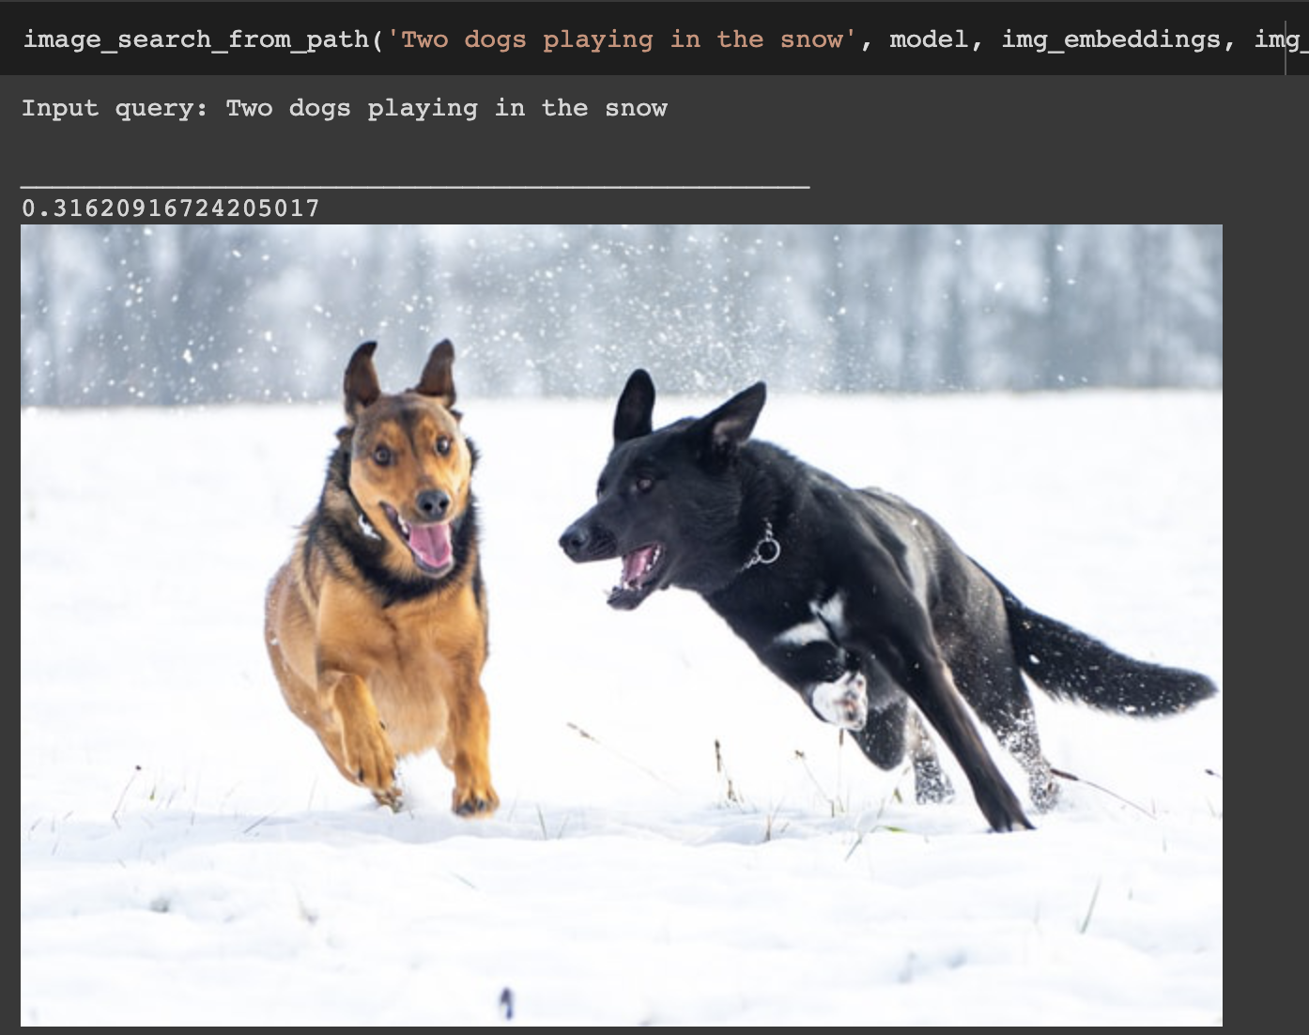
Computer Vision: Image search

Slide 19
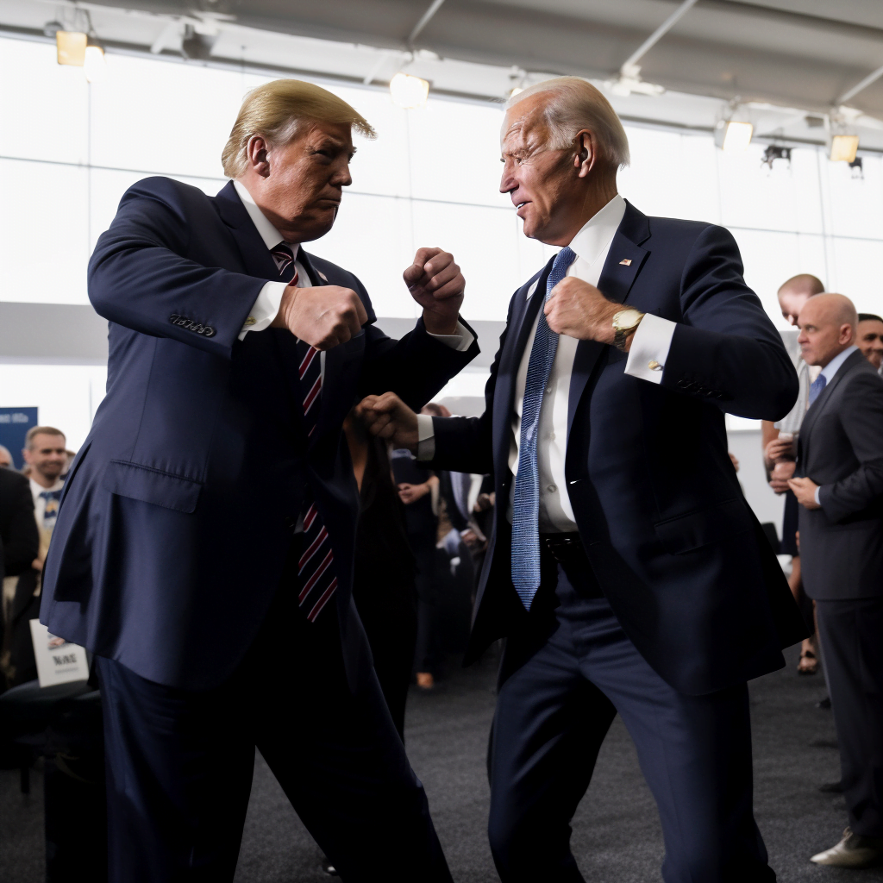
Computer Vision: Image Generation

Slide 20
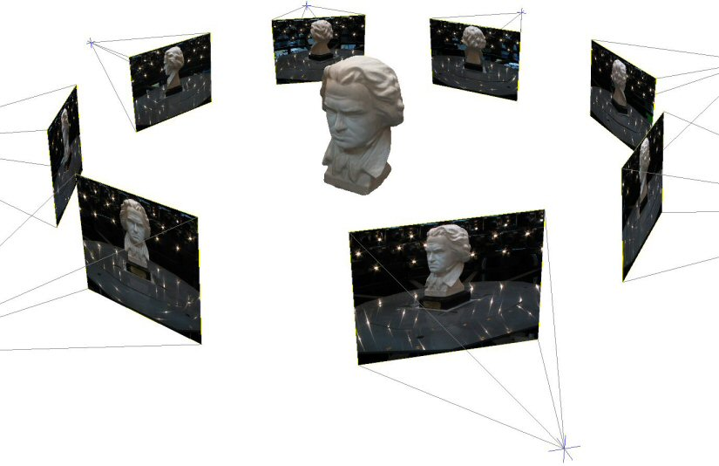
Computer Vision: 3D Reconstruction
Constructs 3D models from 2D images, used in virtual reality, architecture, and entertainment

Slide 21
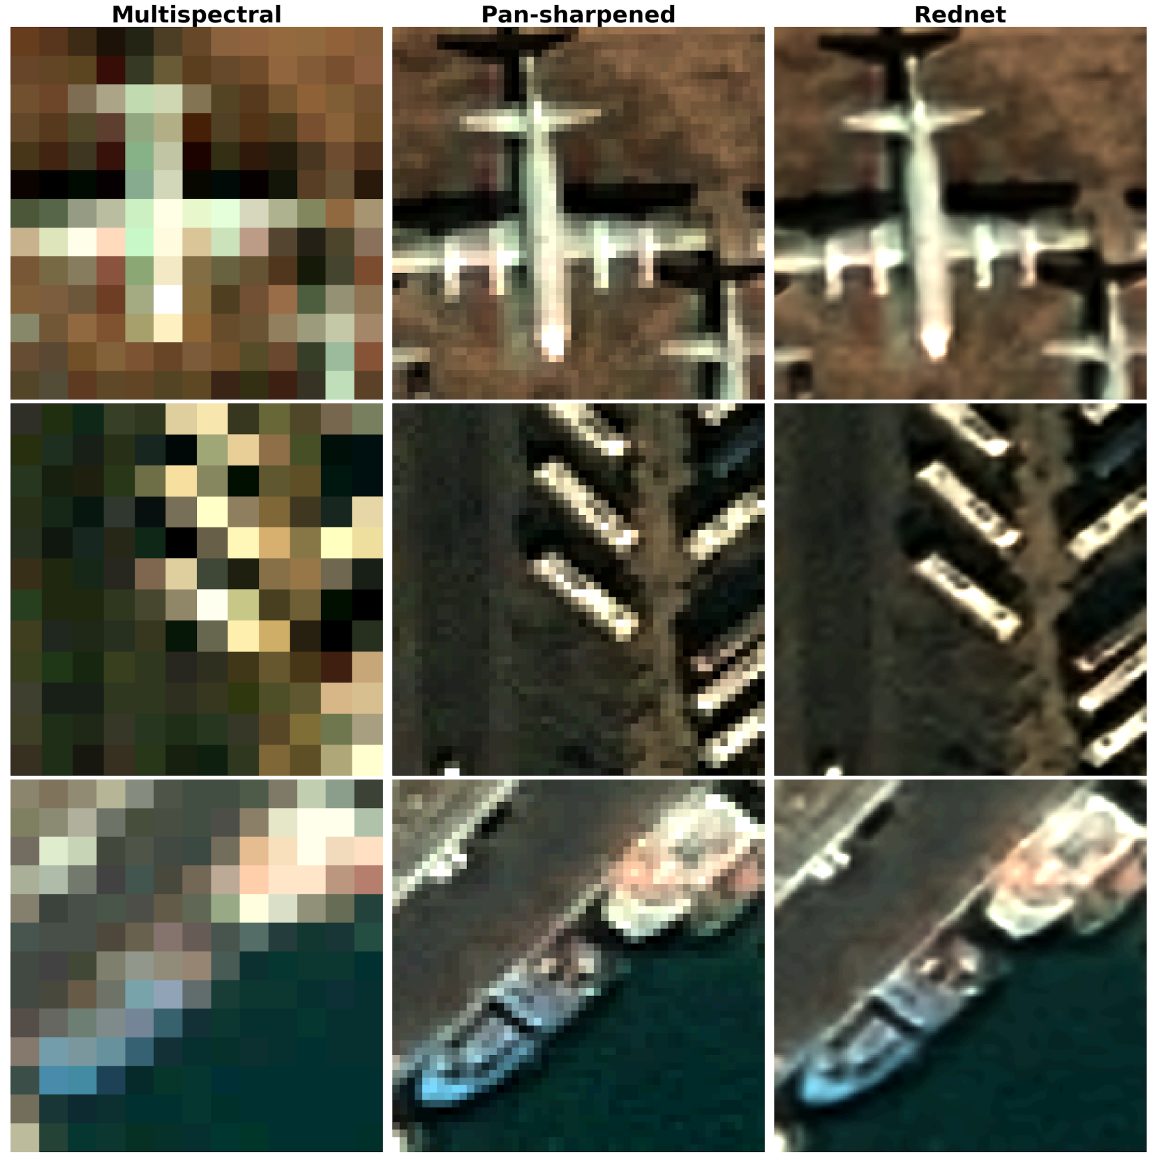
Computer Vision: Super Resolution
Enhances the resolution of images, making them clearer, which is widely used in satellite imaging, medical imaging, and surveillance

Slide 22
2.2
Introduction CNN:

Slide 23
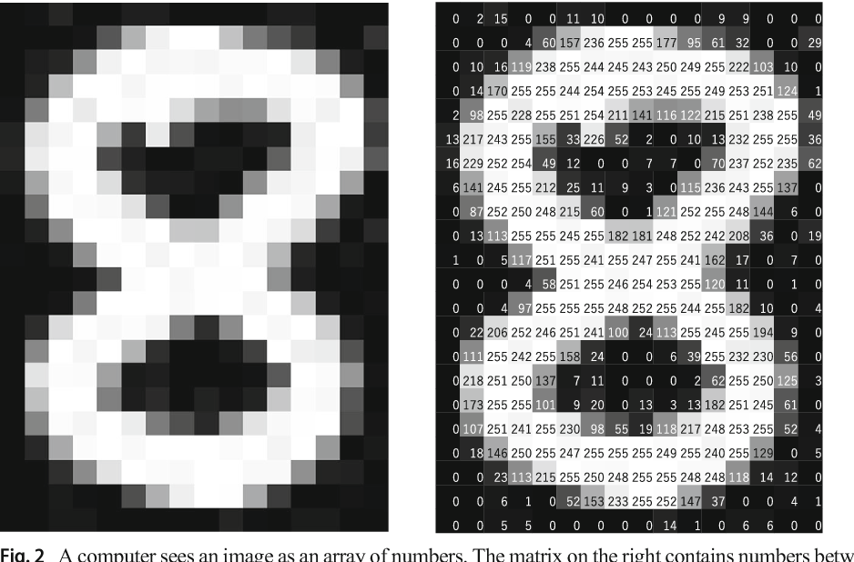
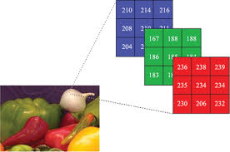
Image Data
Images are composed by pixels. 1 Megapixel can be a 1000x1000 matrix.
Grayscale images can be seen as matrices of integers (0 -255) (black - white).
Coloured images are usually represented as mixes of three colours: Red, Green and Blue (RGB)

Slide 24
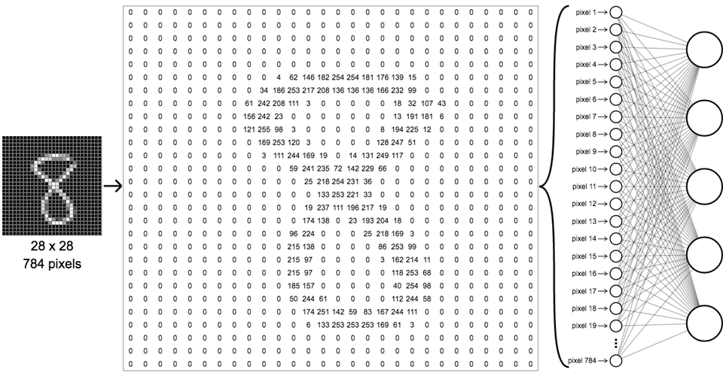
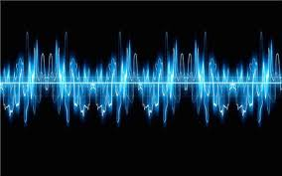
Problem with Dense Layers
1 Megapixel = 1000x1000 = 10^6 inputs.
1000 units hidden layer = 10^9 parameters!!
No spatial information. Collapse 2D => 1D
In most tasks, you can share the same operations in different parts of the image, In a fully-connected layer you learn pixel-by-pixel operations.
Spotify: 44.1kHz sample rate.
Same problems.

Slide 25

Convolution Operation: Intuition
Connect input patch to a single neuron to capture spatial information
Use sliding window to order connections.
3x3 filter, stride = 1 (shift by 1 pixel the sliding window)

Slide 26
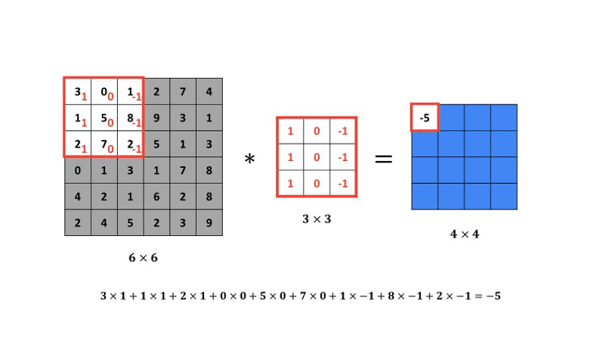



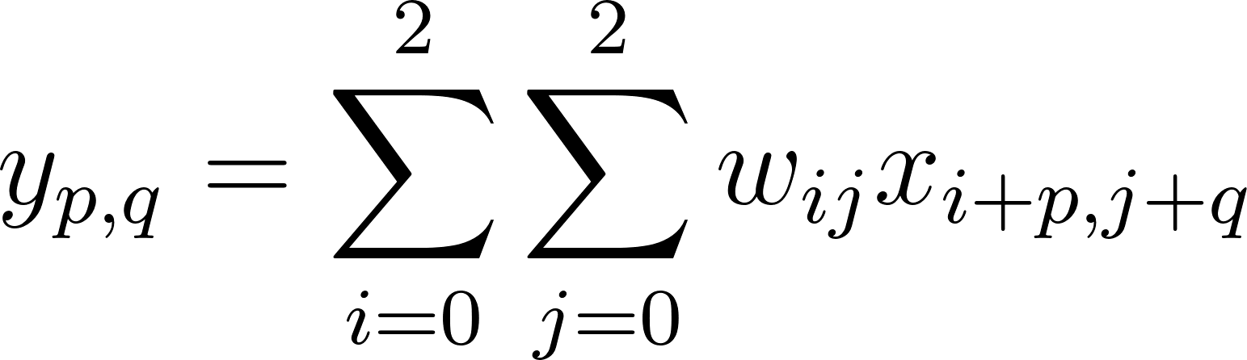
Convolution Operation: Filtering
In mathematics it is called Cross-correlation, In Deep learning convolution.
Operator: *
Dimensions:

Slide 27
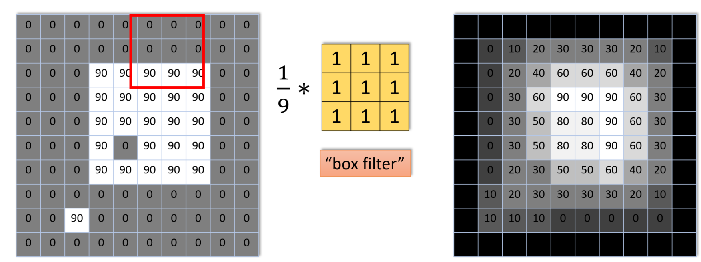
Convolution Operation: Example

Slide 28
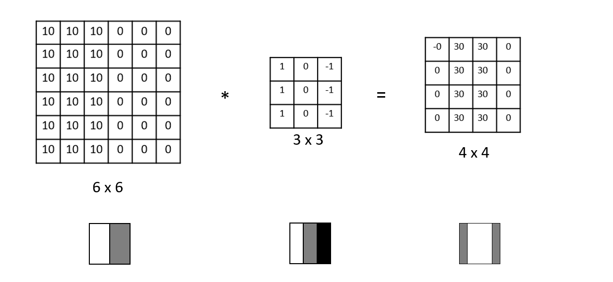
Convolution Operation: Example

Slide 29
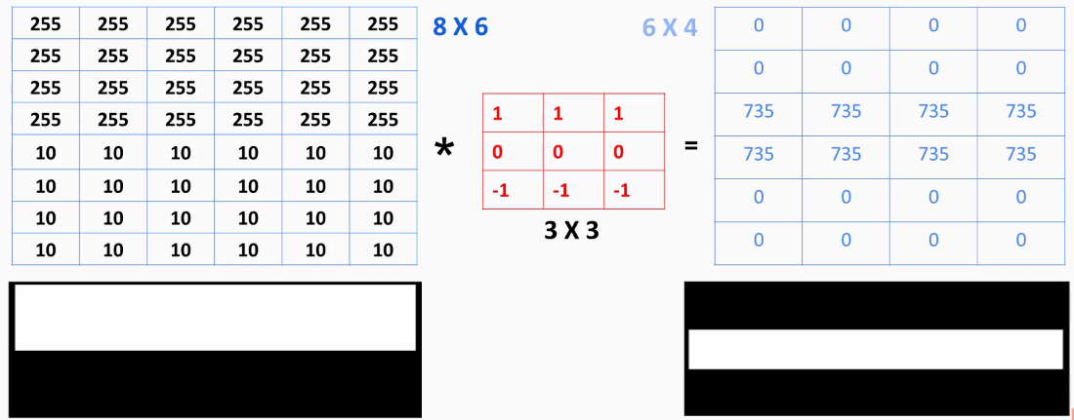
Convolution Operation: Example

Slide 30
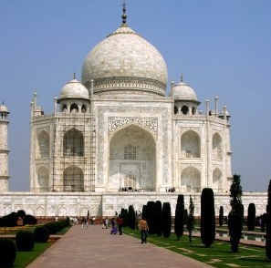
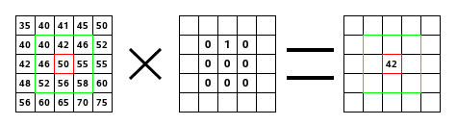
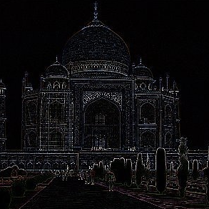
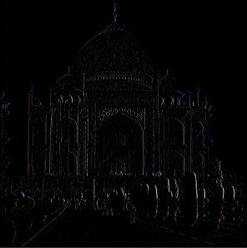
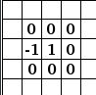
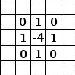
Convolution Operation: Example
Edge Detection
Edge Detection
(right)

Slide 31
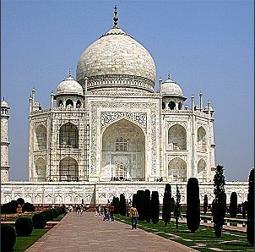
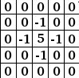
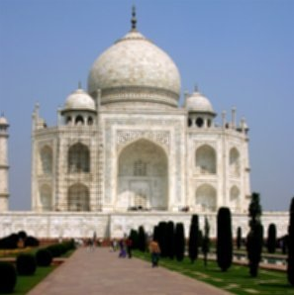
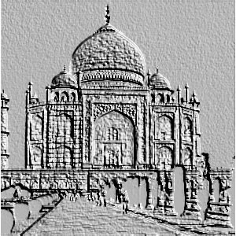
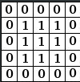
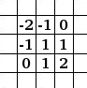
CONVOLUTION EXAMPLES (II)
Convolution Operation: Example
Sharpen
Blur
Emboss
Notes:
Sharpening aims at producing an enhanced image J by increasing the contrast of the given image I along edges, without adding too much noise within homogeneous regions in the image.

Slide 32
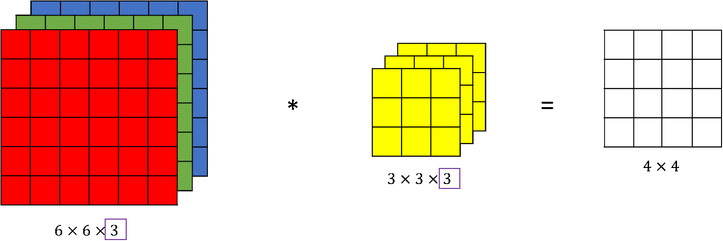
CONVOLUTION EXAMPLES (II)
Convolution Operation: RGB
3 separate convolutions and then sum all 3

Slide 33
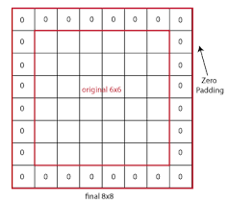
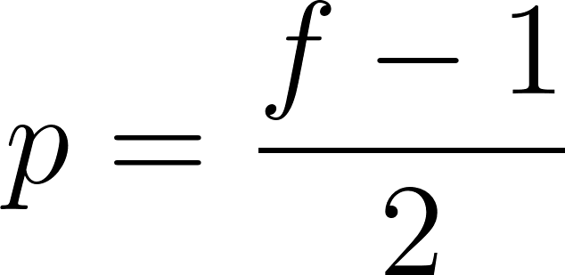
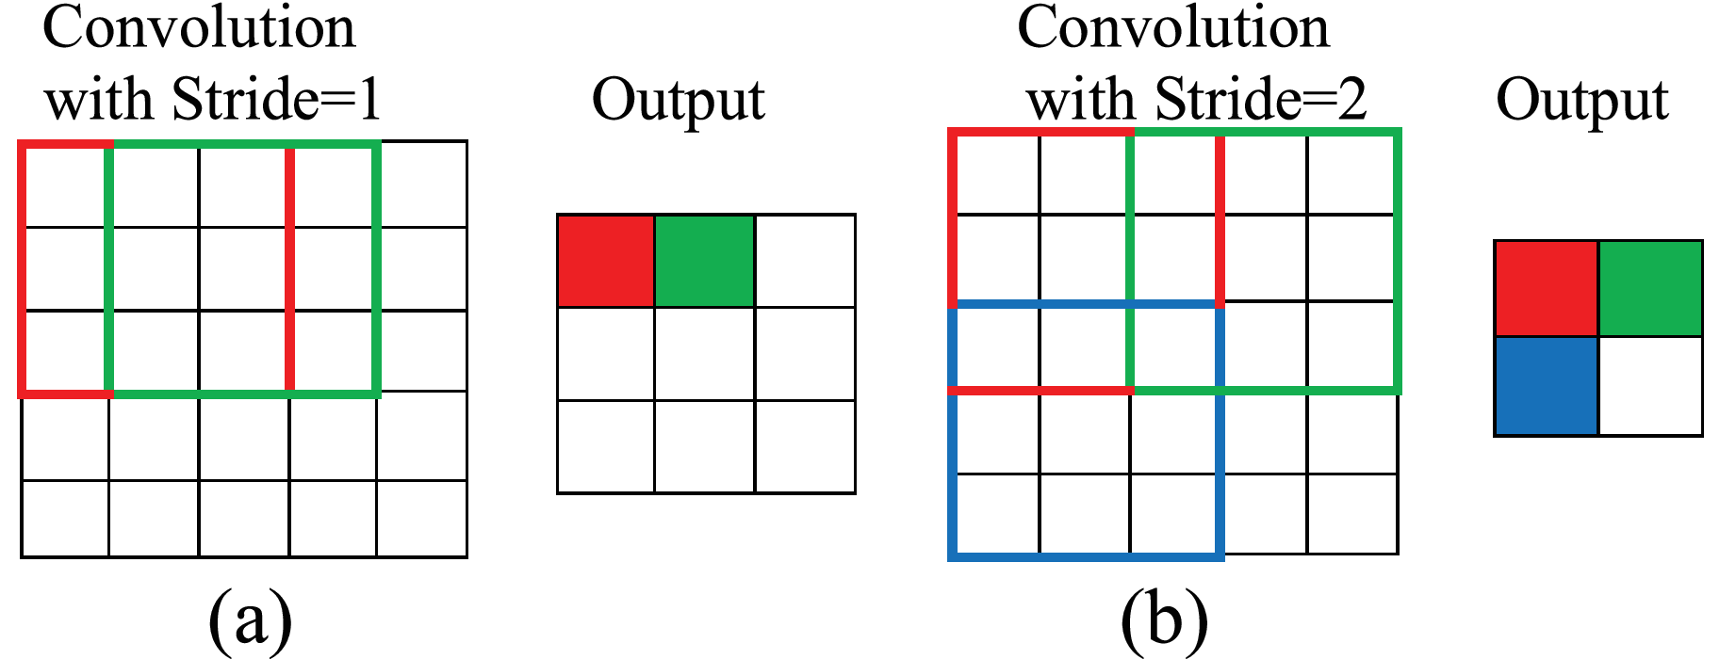
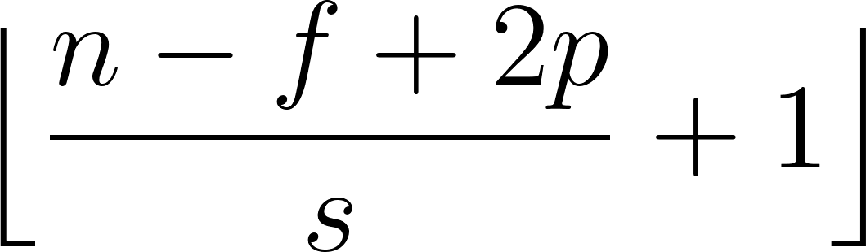
Convolution: Padding & Stride
The image shrinks every time a convolution operation is performed.
Padding (p): amount of zero-pixels added to an image.
Types convolution:
“valid”: No padding (p =0)
“same”: Output size = Input size
Stride: (s) number of rows and columns traversed per slide
Notes:
Como hemos visto, con las convoluciones se reduce el tamaño, no es conveniente en redes muy profundas

Slide 34
CNNs Advantages
Sparse Connections: we need to store fewer parameters, which both reduces the memory requirements of the model and improves its statistical eﬃciency.
Shareable Weights: use the same parameter for more than one
function in a model. Rather than learning a separate set of parameters for every location, we learn only one set. Equivariance to translation, if the input changes, the output changes in the same way.

Slide 35

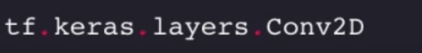
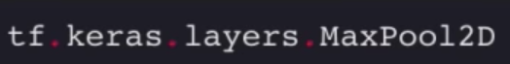

CNN Layers
Convolution + non-linearity (ReLu)
Pooling: Downsampling
Fully-connected

Slide 36
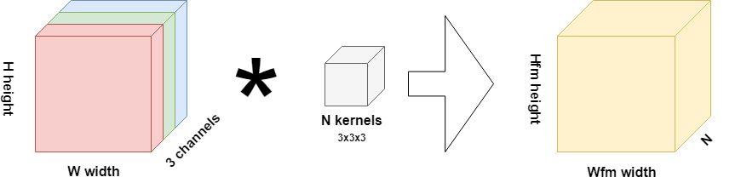
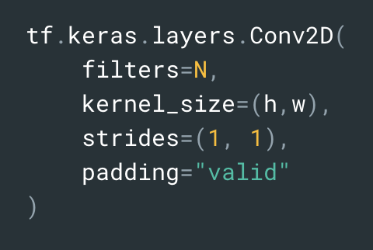
CNN Layers: Convolution
Layer dimensions: (h x w x N) Relu( convolution + b) for every filter (N different filters)

Slide 37
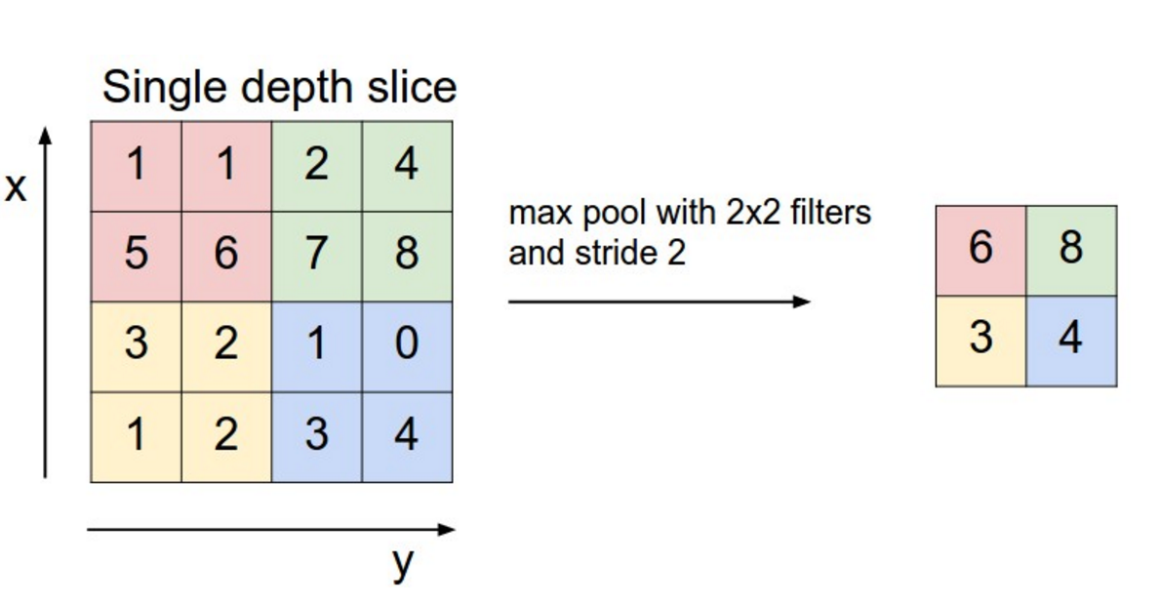
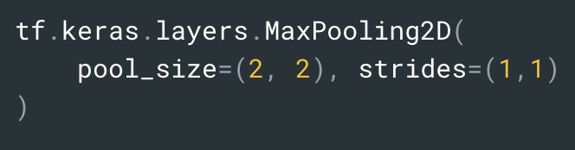
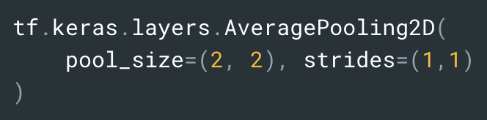
CNN Layers: Pooling
Dimensionality reduction: representations turn smaller and more manageable.
Reduces the number of parameters contributing to a smaller complexity.
Spatial invariance.
MaxPooling and average pooling are the most common.
Backprop is not affected. No parameters to tune.

Slide 38
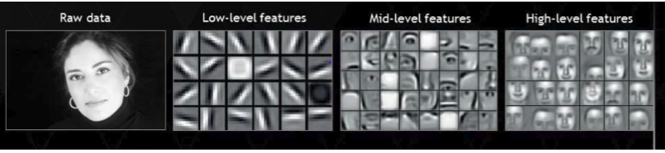
CNN Features
Conv 1
Conv 2
Conv 3

Slide 39

CNN: Data Augmentation
Flip
Rotation
Scale
Translation
Crop
Gaussian Noise
...

Slide 40

CNN: Introduction - Until Transfer Learning

Slide 41

CNN: Transfer learning
Instead of training a Deep Neural Net from scratch for your task:
Take a network trained on a different domain for a different task
Adapt it for your domain and your task

Slide 42
CNN: Fine-tuning
We not only update the CNN architecture but also re-train it to learn new object classes.

Slide 43


Slide 44
CNN: Introduction & Classical Architectures

Slide 45
DL Interpretability
Conv 1
Conv 2
Conv 3

Slide 46
CNN Features: Interpretability
🌊 1. Saliency Maps (Simonyan et al., 2013)
Highlights which pixels most affect the output by computing input gradients.
https://arxiv.org/abs/1312.6034
🔮 2. DeepDream (Google, 2015)
Visualizes what excites neurons using gradient ascent on input images.
https://research.google/blog/inceptionism-going-deeper-into-neural-networks/
🔥 3. Grad-CAM (Selvaraju et al., 2017)
Generates class-specific heatmaps by weighting convolutional feature maps with gradients.
https://arxiv.org/abs/1610.02391

Slide 47

CNN Features: Interpretability
🌊 1. Saliency Maps (Simonyan et al., 2013)
Goal: Identify which pixels in an input image are most responsible for a model’s prediction for a given class
Compute the gradient of the output score (for a given class) with respect to each pixel in the input image.
This tells you: “If I change this pixel slightly, how much does the class score change?”
Algorithm
Forward pass the input image to compute class scores.
Compute the gradient of the target class score w.r.t. the input image.
The resulting gradient indicates how changes in each pixel would affect the class score.
Take the absolute value or maximum across channels to generate the saliency map.
Optionally normalize and visualize as a grayscale or heatmap overlay.

Slide 48

CNN Features: Interpretability
🔮 2. DeepDream (Google, 2015)
The output of a filter applied to an image gives you the feature map, but it doesn’t tell you anything about what the filter learned.
Q: “What would be the image that would maximize the activation of this filter ?”

Slide 49

CNN Features: Interpretability
🔮 2. DeepDream (Google, 2015)
Maximize ? -> Optimization !
Start with a random pixel image and the already trained network filters
How would iteratively modifying these pixels would affect the feature maps out of any filter of the network ?

Slide 50

CNN Features: Interpretability
🔮 2. DeepDream (Google, 2015)
2. We can use gradient descent to compute the optimal pixel distribution that will maximize the activation of the resulting feature map for a given filer

Slide 51

CNN Features: Interpretability
🔮 2. DeepDream (Google, 2015)
3. And then we can aggregate for all the filters to get the image that would

Slide 52

CNN Features: Interpretability
🔥 3. Grad-CAM (Selvaraju et al., 2017)
Goal: Identify the image regions that most influence a model’s prediction for a specific class.
Uses the gradients of the target class flowing into the final convolutional layer to produce a coarse localization heatmap that highlights important regions in the input image
Algorithm
Forward pass the image through the network to get the raw class scores (pre-softmax).
Compute gradients of the class score (e.g., for class “cat”) w.r.t. the feature maps of the last convolutional layer.
Global average pool the gradients across spatial dimensions (height and width) to get one weight per channel — representing neuron importance.
Weight the forward feature maps by these importance scores.
Apply ReLU to the weighted sum to retain only the positively influencing features.
Upsample the resulting heatmap to the input image size for visualization.

Slide 53



CNN Features: Interpretability
https://adataodyssey.com/grad-cam/

Slide 54

CNN Features: Interpretability

Slide 55
Practice: Visualize what CNN learns

Slide 56

Modern Architectures: Revolution on Depth
Human Beings : Top-5 Error Rate – 5.1%
Source: https://medium.com/@Lidinwise/the-revolution-of-depth-facf174924f5
Notes:
it turns out that, thanks to some problems like vanishing gradients and curse of dimensionality, if we have sufficiently deep networks, it may not be able to learn simple functions like an identity function. Now this is clearly undesirable.
Also, if we still keep increasing the number of layers, we will see that the accuracy will start to saturate at one point and eventually degrade

Slide 57

Modern Architectures: Revolution on Depth
Source: https://medium.com/@Lidinwise/the-revolution-of-depth-facf174924f5
Notes:
it turns out that, thanks to some problems like vanishing gradients and curse of dimensionality, if we have sufficiently deep networks, it may not be able to learn simple functions like an identity function. Now this is clearly undesirable.
Also, if we still keep increasing the number of layers, we will see that the accuracy will start to saturate at one point and eventually degrade

Slide 58

Modern Architectures: GoogleNet, Inception blocks
Networks with Parallel Concatenations
The Inception block is equivalent to a subnetwork with four paths
Source: d2l.ai
Notes:
it turns out that, thanks to some problems like vanishing gradients and curse of dimensionality, if we have sufficiently deep networks, it may not be able to learn simple functions like an identity function. Now this is clearly undesirable.
Also, if we still keep increasing the number of layers, we will see that the accuracy will start to saturate at one point and eventually degrade

Slide 59

Modern Architectures: ResNet
Increasing network depth does not work by simply stacking layers together.
You can skip the training of few layers using skip-connections or residual connections.
The residual block can learn the identity function more easily.
Source: d2l.ai
Notes:
2015
it turns out that, thanks to some problems like vanishing gradients and curse of dimensionality, if we have sufficiently deep networks, it may not be able to learn simple functions like an identity function. Now this is clearly undesirable.
Also, if we still keep increasing the number of layers, we will see that the accuracy will start to saturate at one point and eventually degrade

Slide 60

Modern Architectures:
https://keras.io/api/applications/

Slide 61
Practice: Custom Dataset - PyTorch

Slide 62
2.3
Use Cases:

Slide 63



Image Classification
Multi-class classification
Multi-Label classification
Cat
Dog
Dog, cat

Slide 64

Image Classification

Slide 65

Object Localization

Slide 66



Object Localization II
Sigmoid: Is there an object?
Bounding box, ReLu
Target:
Classes of objects, softmax

Slide 67



Object Detection: Sliding Windows

Slide 68

Object Detection: Popular Algorithms
R-CNN
Faster -RCNN
YOLO
SSD
Suggested Blogs for further reading:
https://lilianweng.github.io/posts/2017-12-31-object-recognition-part-3

Slide 69
Object Detection: R-CNN
Original Paper: “Rich feature hierarchies for accurate object detection and semantic segmentation”. 2014
PyTorch (not official) implementation: https://github.com/cassiePython/RCNN. Original was implemented in MATLAB/Caffe.
R-CNN was the first deep-learning-based detector, achieving a 30% relative mAP boost over previous HOG-based models
Summary:
A two-stage object detector that significantly improved detection accuracy (53.3% mAP on VOC2012) by applying deep CNNs to region proposals
Rather than exhaustively sliding a window, it uses an external algorithm (Selective Search) to generate ~2,000 candidate regions that may contain objects.
Each region proposal is warped to a fixed size and fed through a CNN (e.g. AlexNet) to extract a feature vector.
These features are then classified using class-specific linear SVMs, and each proposal’s bounding box is refined with a linear regressor.
Non-maximum suppression is applied to filter overlapping detections

Slide 70

Object Detection: R-CNN

Slide 71
Object Detection: Fast-RCNN
Original Paper: “Fast R-CNN”. 2015
PyTorch (not official) implementation: https://github.com/adityaarun1/pytorch_fast-er_rcnn
Summary:
This paper introduced improvements to R-CNN that greatly increased speed and efficiency while also improving accuracy
Fast R-CNN addressed R-CNN’s speed bottlenecks by sharing the heavy CNN computation across proposals.
Instead of cropping each region and running a CNN on each (as R-CNN does), Fast R-CNN runs the CNN once per image to produce a feature map.
Then uses Region of Interest (RoI) Pooling to extract fixed-length feature vectors for each proposal from that shared feature map
Finally, a single network branch predicts both the class label and a refined bounding box for each proposal (using a softmax classifier and linear regressor)
The SVMs and separate regression of R-CNN are replaced with this integrated, multi-task loss training
These changes made Fast R-CNN dramatically faster and end-to-end trainable – 9× faster training and 213× faster inference than R-CNN with VGG16 , while also slightly improving mAP

Slide 72

Object Detection: Fast-RCNN

Slide 73

Object Detection: Fast-RCNN
Fast R-CNN gets many regions (ROIs) from an image using Selective Search.
Each region can be a different shape and size (like a tall person vs. a wide car).
But the classifier at the end wants fixed-size inputs (e.g., 7×7).

Slide 74
Object Detection: Faster R-CNN
Original Paper: “Faster R-CNN: Towards Real-Time Object Detection with Region Proposal Network”. 2015
The official implementation was released in MATLAB/Python (Caffe). In PyTorch, Detectron2 (by Facebook AI) and Torchvision provide implementations of Faster R-CNN (e.g. torchvision.models.detection.fasterrcnn_resnet50_fpn) that are widely used and well-documented. These implementations incorporate the RPN and Fast R-CNN head in a unified model.
Summary:
This work introduced the Region Proposal Network (RPN) to learn region proposals, making the detection pipeline nearly fully CNN-based. RPN predicts object proposals directly from the convolutional feature map
The model is a single unified network with two modules sharing the base CNN features:
The RPN, which slides over the feature map and predicts multiple region boxes (anchors) at each location along with objectness scores
The Fast R-CNN detection head that classifies the proposals and refines their bounds
The network is trained end-to-end, alternating between training the RPN and the detector, eventually convergence to a unified mode.
🧠 What’s the problem? In R-CNN and Fast R-CNN, we needed an external algorithm (like Selective Search) to find possible object regions.But that’s slow and not learnable.

Slide 75

Object Detection: Faster R-CNN

Slide 76


Slide 77
Object Detection: YOLO
Original Paper: “You Only Look Once: Unified, Real-Time Object Detection”. 2016
PyTorch Implementation: The original YOLO was implemented in C (Darknet). For a PyTorch implementation, the Ultralytics YOLOv5 repository is a popular choice – it’s well-documented and widely used (20K+ stars).
Summary:
This work introduced the first one-stage detector to unify object detection in a single neural network, enabling real-time performance.
The input image is divided into a SxS grid. Each grid cell is responsible for detecting objects whose center falls inside that cell.
A single CNN processes the whole image and outputs, for each grid cell, a fixed number of bounding box predictions (with confidences) and class probabilities.
At inference, the model yields a set of predicted boxes across the image, which are then filtered by thresholding confidence and applying non-max suppression.
YOLO’s unified design initially traded off some accuracy for speed – e.g., it made more localization errors compared to slower R-CNN-based models
It significantly reduced background false detections and showed strong generalization

Slide 78

Object Detection: YOLO

Slide 79

Object Detection: YOLO

Slide 80

Semantic Segmentation vs Object Detection

Slide 81


Semantic Segmentation: Per Pixel Class Labels

Slide 82

Semantic Segmentation vs Instance Segmentation

Slide 83
Image Segmentation: Use Cases
Medical imaging
Interactive editing tools (like Photoshop)
Robotics and AR (object understanding)
Visual grounding with LLMs (e.g., captioning, VQA)

Slide 84
Image Segmentation: Popular Algorithms
Pre-CNN Era:
Rule-based systems based on edge detection and thresholding
CNN-based Era:
FCN: Fully Convolutional Networks
Mask R-CNN
Transformers
Segmenter
Foundation Models Shift
SAM
SAM 2

Slide 85

Semantic Segmentation: FCN
An FCN (Fully Convolutional Network) is a neural network that replaces all fully connected layers with convolutional layers, so it can output pixel-level predictions for any input size.
Remove the fully connected layers.
Use 1×1 convolutions to produce class scores at each spatial location.
Then use upsampling / transpose conv (a.k.a. deconvolution) to resize the low-res output back to the original image size.

Slide 86
Semantic Segmentation: FCN
Structure
Backbone: CNN (e.g., VGG, ResNet) → outputs a low-res feature map, say 14×14×512
1×1 Conv: reduces depth → from 512 → C (number of classes), now we have 14×14×C
Upsampling: brings 14×14 back to 224×224, giving final segmentation map (224×224×C)
It’s a learned way to upsample a feature map by spreading each pixel over a larger area using trainable filters.
Reconstructing a full-size image by placing each pixel into a larger canvas, using learned rules to fill in the gaps.

Slide 87
Instance Segmentation: Mask R-CNN
Mask R-CNN extends Faster R-CNN to also predict a segmentation mask (pixel-wise object shape) for each detected object. It does object detection + instance segmentation in one unified model.
Backbone CNN (e.g., ResNet) Extracts feature maps from the input image.
Region Proposal Network (RPN) Proposes Regions of Interest (ROIs) — same as Faster R-CNN.
ROI Align Extracts fixed-size feature maps for each ROI using bilinear interpolation, avoiding the coarse rounding of ROI Pooling.
Three outputs per ROI:
🟨 Classification head — What object is it?
🟥 Bounding box regression — Where is it?
🟩 Mask head — A small FCN (Fully Convolutional Network) that outputs a binary mask (e.g., 28×28) for the object only for the predicted class.

Slide 88
Instance Segmentation: Mask R-CNN
ROI Align
🤔 Problem with ROI Pooling (used in Fast/Faster R-CNN)
ROI Pooling divides each region into a grid, and then rounds the coordinates to fit into the grid.
This rounding causes misalignment between the feature map and the original region — not great when you want pixel-level accuracy (like for masks!).
✅ ROI Align: What it does differently
ROI Align avoids quantization — it keeps fractional coordinates and uses bilinear interpolation to extract features more precisely.
🧠 Why It Matters
For classification and bounding boxes: slight misalignment is okay.
For segmentation masks, every pixel matters — misalignment = blurry masks or shifted predictions.

Slide 89
Image Segmentation: SAM
Release: April 2023 by Meta AI.
Goal: Create a foundation model for segmentation — akin to how GPT is for language.
Core Idea: Given an image and a prompt (like a point, box, or mask), SAM returns the corresponding object segmentation mask.
Model structure:
Uses a ViT (Vision Transformer) as image encoder.
A prompt encoder converts user inputs (points, boxes, masks).
A mask decoder outputs segmentation masks in under 50ms.
Strengths:
Zero-shot generalization to unseen objects.
Interactive: Users can refine results with clicks or other prompts.
Trained on a massive dataset: SA-1B with 1.1B masks on 11M images.

Slide 90
Practice: Object Detection - YOLO

Slide 91



Neural Style Transfer
(C)
(S)
(G)
Paper : A Neural Algorithm of Artistic Style

Slide 92



Neural Style Transfer: Visualizing Deep Layer
Use pre-trained model for extracting content and style (VGG-19).
Inputs: a pair of images, style and content.
Extract style from image S
Extract content from image C
Generate a new imagen with a training loop (gradient descend)
Optimize Generated image G
(S)
(C)
(G)

Slide 93

Neural Style Transfer: Visualizing Layers

Slide 94

Neural Style Transfer: Visualizing Deep Layer
VGG-19
Content Loss
Total Loss
Style Loss
Train loop

Slide 95






Neural Style Transfer

Slide 96








Face Recognition/Verification: Siamese Net
Verification: Input: Image and name => Correct/Wrong
Recognition: Input: Image => name (K possibilities) (much harder)
One-shot learning: Recognize a person given a single image. Small training set is not enough for training a CNN. Not need a classifier, use similarity function.
Encoded vector : dim 128
Distance measure between images

Slide 97


Face Recognition/Verification: Triplet Loss
Train triplets: Anchor, Negative and Positive.
We want the distance between anchor and positive be lower than the distance between the anchor and the negative image.
Train with more similars negative examples.

Slide 98


Siamese Net: Other Applications
How old are you?
What is your age?
Handwritten Signature
Voice check
Question duplicates

Slide 99
Practice: Introduction to Hugging Face

